Slide 1
Chongqing University of Technology
ATAI
Advanced Technique of Artificial Intelligence
Chongqing University of Technology
Global-Local Mutual Attention Model for Text Classification
(IEEE-2019.12)
Reported by Ling Zhu

Slide 2
Chongqing University of Technology
ATAI
Advanced Technique of Artificial Intelligence
Chongqing University of Technology
1. Innovation
2. Method
3. Experiments
4. Conclusion

Slide 3
Innovation
1. Global-Local Mutual Attention Model
2. weighted-over-time pooling
aggregate the most information
LGGA
local-guided global-attention
GLMA
capturing complex combined semantics
GGLA
Global-Local Mutual Attention
global-guided local-attention
extracting key local semantic features

Slide 4
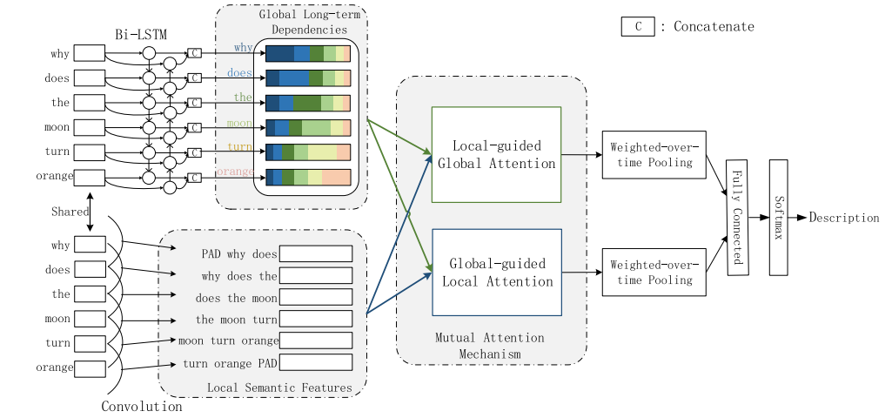
Approach

Slide 5
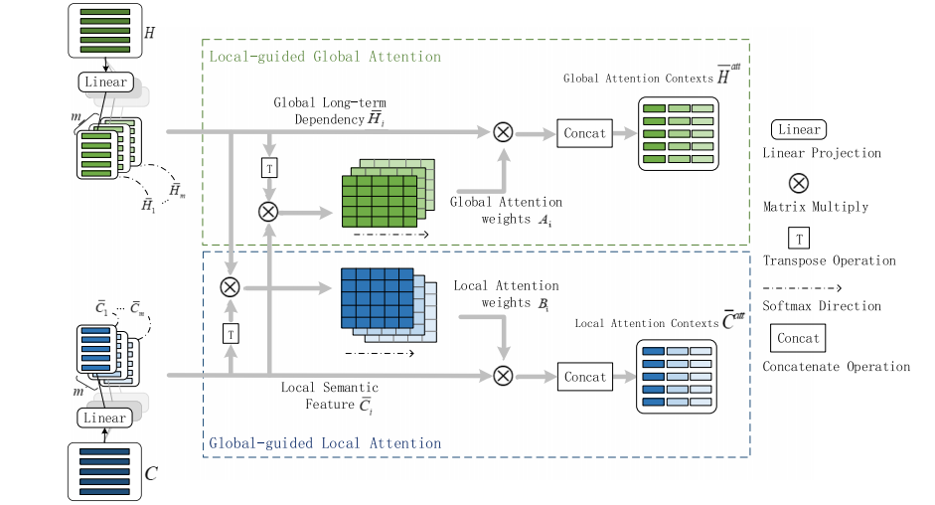
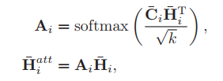
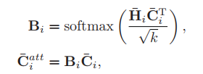
Approach
Local-guided Global Attention
i表示第i个head头
Global-guided Local Attention

Slide 6
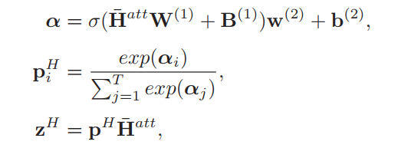
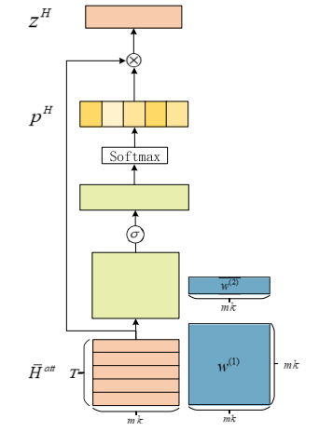
Approach
Weighted-Over-Time Pooling
learnable parameters

Slide 7
Experiments

Slide 8
Experiments

Slide 9
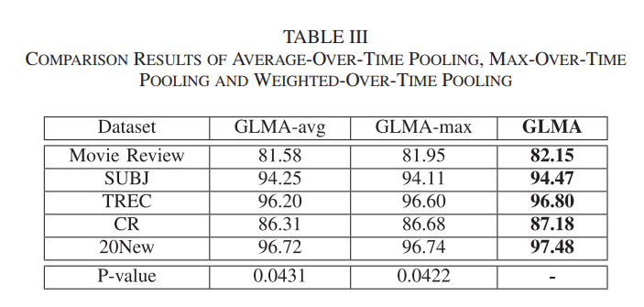
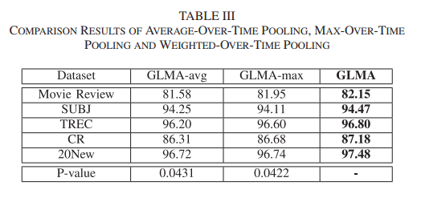
Experiments

Slide 10
Experiments

Slide 11
Conclusion
1.propose a novel Global-Local Mutual Attention (GLMA) model with a mutual attention mechanism 2.A weighted-over-time pooling operation is proposed to aggregate the most informative and discriminative features

Slide 12
Thanks

